Slide 1
Travel PLANNER agent
IBM AICTE PROJECT
Presented By: S.PRAANESH
Student name :S.PRAANESH
College Name & Department : SRM IST (RMP)

Slide 2
OUTLINE
Problem Statement
Technology used
Wow factor
End users
Result
Conclusion
Git-hub Link
Future scope
IBM Certifications

Slide 3
Problem Statement
Modern travelers often face difficulties in planning end-to-end trips that match their preferences, budget constraints, and time limitations. The abundance of travel-related information—flights, accommodations, attractions, transportation options, and local experiences—across disparate platforms overwhelms users, leading to suboptimal travel plans and low satisfaction. There is a pressing need for an intelligent, personalized travel planning solution that can understand user preferences, optimize scheduling, and integrate real-time data to provide hassle-free, holistic itineraries.
Proposed Solution: Develop an AI Research Agent using advanced NLP and RAG techniques to streamline the research process. The agent will:
Literature Retrieval: Fetch relevant papers, reviews, and datasets from academic databases using natural language queries.
Automated Summaries: Provide clear, context-aware summaries of papers or research topics tailored to user needs.
Gap & Trend Analysis: Detect underexplored areas, unresolved questions, and emerging themes in the literature.
Smart Recommendations: Suggest relevant papers, datasets, and potential collaborators based on user interests and research history.

Slide 4
Technology used
IBM cloud lite services
Natural Language Processing (NLP)
Retrieval Augmented Generation (RAG)
IBM Granite model

Slide 5
IBM cloud services used
IBM Cloud Watsonx AI Studio
IBM Cloud Watsonx AI runtime
IBM Cloud Agent Lab
IBM Granite foundation model

Slide 6
Wow factors
Real-Time, Up-to-Date Research Access: Combines semantic search with RAG to provide the latest, most relevant papers and data instantly, ensuring users always work with current information.
Deep Automated Summarization: Produces clear, concise, and context-aware summaries of complex scientific literature, saving researchers hours of manual reading.
Insightful Research Gap & Trend Detection: Goes beyond retrieval to analyze vast literature, identifying unexplored areas and emerging trends that guide strategic research directions.
Personalized Recommendations: Tailors suggestions of papers, datasets, and collaborators uniquely to each researcher’s profile and ongoing projects for maximal impact.
Interactive, Natural Language Q&A: Allows dynamic, conversational engagement where users ask detailed questions and receive expert-level explanations grounded in current research.
Collaboration Facilitation: Uses advanced relationship mapping to connect researchers with ideal collaborators, fostering innovation and cross-disciplinary partnerships.
Continuous Learning: Improves over time by incorporating user feedback, making the agent smarter and more aligned with researcher needs.

Slide 7
End users
Academic Researchers
Research Institutions and Universities
Industry R&D Teams
Educators

Slide 8
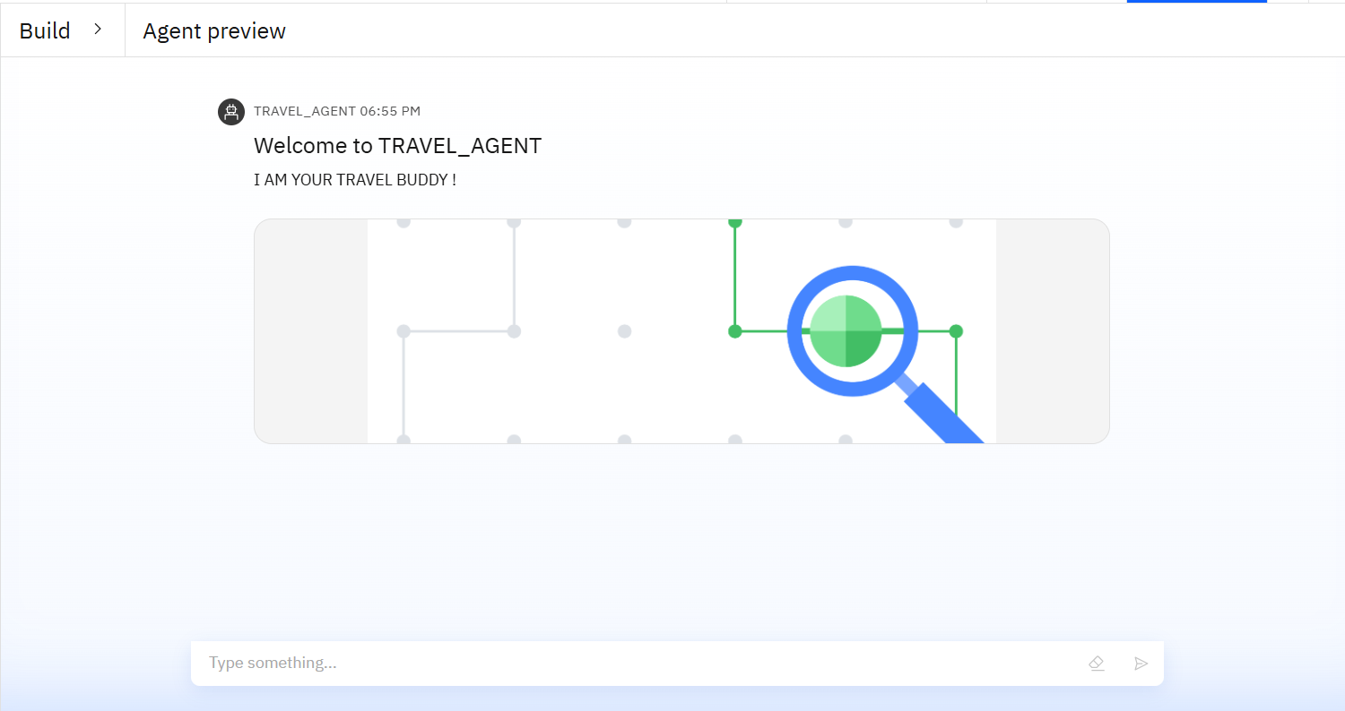
Results

Slide 9
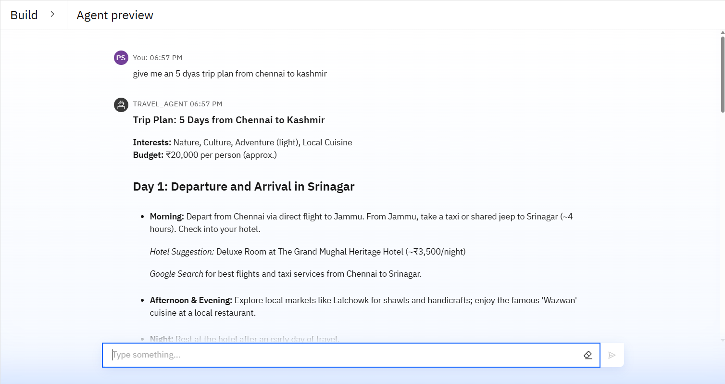
Results

Slide 10
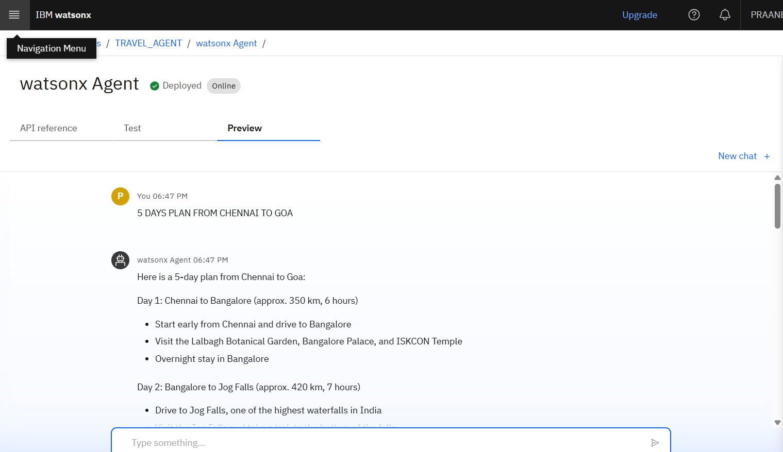
Results
Deployed AI Agent

Slide 11
Future scope
Multimodal Integration: Extend capabilities to include not just text-based research papers but also figures, charts, videos, and audio from conferences and presentations for richer insights.
Cross-Domain Research Support: Enable seamless literature review and knowledge synthesis across multiple disciplines, fostering interdisciplinary research breakthroughs.
Real-Time Collaboration Features: Integrate collaborative workspaces that allow multiple researchers to co-curate literature reviews, share annotations, and discuss findings within the platform.
Advanced Personalization: Employ deeper user profiling with adaptive learning to tailor recommendations not only based on past activity but also evolving research priorities and emerging interests.
Hypothesis Generation & Validation: Assist researchers in generating new hypotheses grounded in literature gaps and available data, and suggest experiments or data analyses for validation.

Slide 12
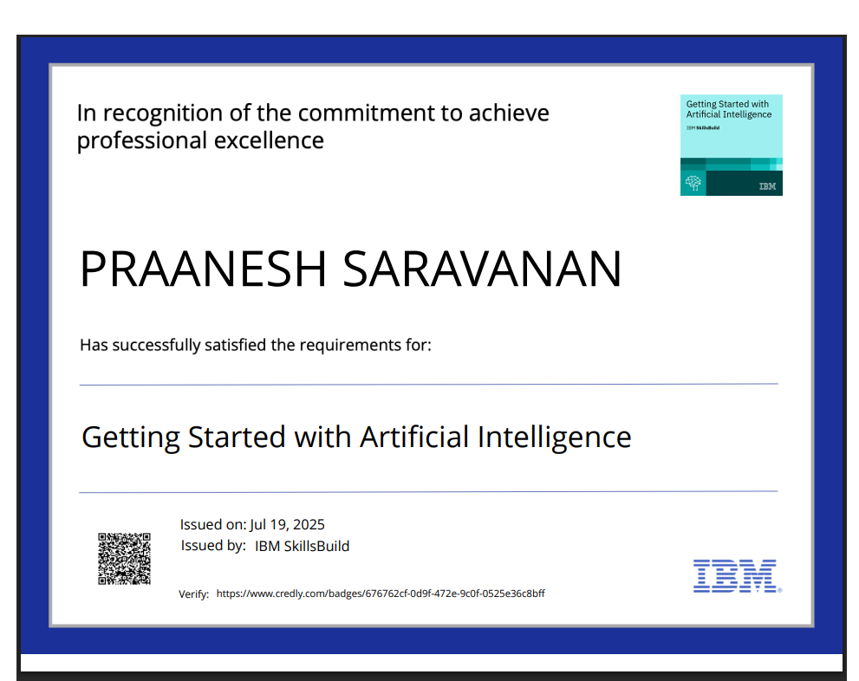
IBM Certifications

Slide 13
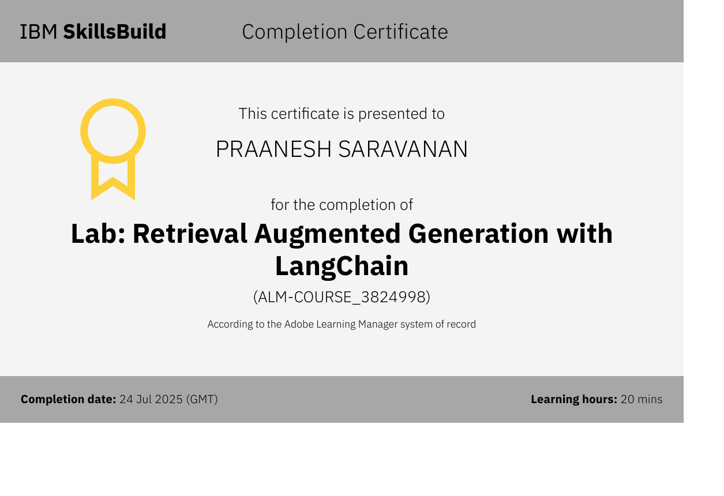

Slide 14
GitHub Link
Git hub link :https://github.com/S-PRAANESH/Travel_Planner_Agent

Slide 15
THANK YOU

